Slide 1
On Twitter Purge: A Retrospective Analysis of Suspended Users
Authors: Farhan Asif Chowdhury, Lawrence Allen, Mohammad Yousuf, and Abdullah Mueen
Published in The Companion Proceedings of the Web Conference, 2020 (WWW ’20 Companion)
Presented by Tarannum Zaki
CS 895: Web Archiving Forensics
Old Dominion University
Norfolk, Virginia
Fall 2022
November 21, 2022
Tarannum Zaki CS 895: Web Archiving Forensics On Twitter Purge @tarannum_zaki @WebSciDL

Slide 2
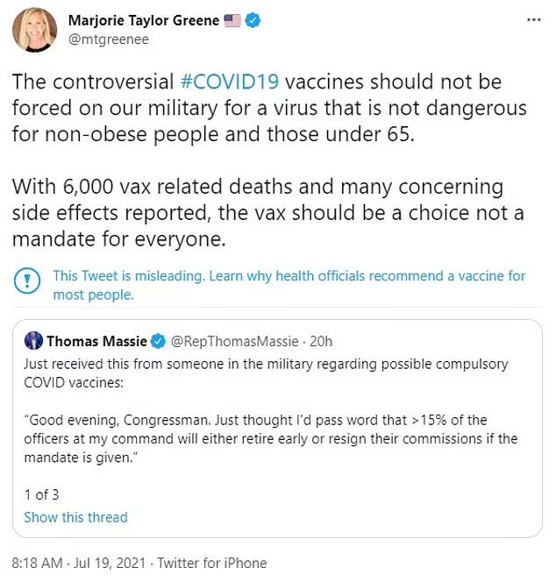
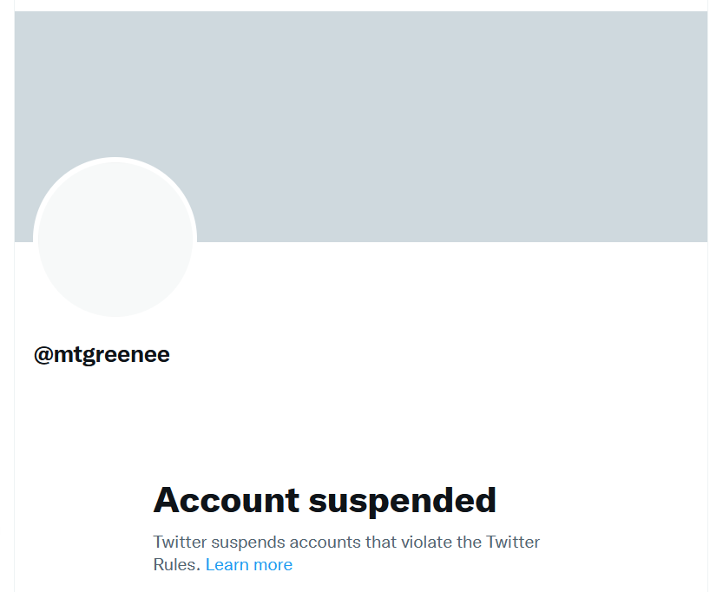
When and Why Twitter Suspends Users?
Controversial posts -
Extremist and abusive statements
Violates Twitter rules and community guidelines
Prevent abuse and spam on social media
https://i.dailymail.co.uk/1s/2021/07/20/06/45652605-9805117-image-a-55_1626759924745.jpg
https://twitter.com/mtgreenee
https://www.dailymail.co.uk/news/article-9880035/Marjorie-Taylor-Greene-suspended-Twitter-WEEK-saying-vaccines-failing.html
Tarannum Zaki CS 895: Web Archiving Forensics On Twitter Purge @tarannum_zaki @WebSciDL

Slide 3
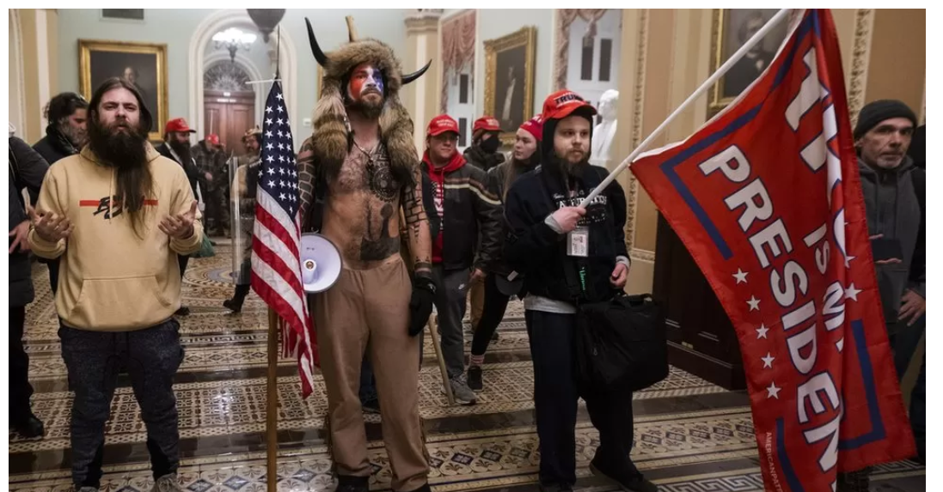
What is Twitter Purge?
Twitter suspends 70,000 accounts linked to QAnon
https://ichef.bbci.co.uk/news/976/cpsprodpb/863C/production/_116446343_hi065085179.jpg
Tarannum Zaki CS 895: Web Archiving Forensics On Twitter Purge @tarannum_zaki @WebSciDL

Slide 4
Motivation
A more general group of users are suspended based on an event but what are the characteristics of the Twitter users being purged on a regular basis?
Tarannum Zaki CS 895: Web Archiving Forensics On Twitter Purge @tarannum_zaki @WebSciDL

Slide 5
Objective
To perform a retrospective analysis on purged Twitter accounts in order to characterize their account properties and behavioral activities.
Tarannum Zaki CS 895: Web Archiving Forensics On Twitter Purge @tarannum_zaki @WebSciDL

Slide 6
Research Questions
RQ1: What makes the purged users different from regular Twitter users?
RQ2: What was the role of suspended users before the purge?
RQ3: Were there interactions among the purged users?
Tarannum Zaki CS 895: Web Archiving Forensics On Twitter Purge @tarannum_zaki @WebSciDL

Slide 7
Methodology
Data Collection
Account Characteristics
Content Analysis
Interaction and Communities
Detecting purged users
Creating the control dataset
Collecting tweets
Account creation
Distributional properties
Language and location
Across language
Topics and user groups
Identifying group level characteristics
Tarannum Zaki CS 895: Web Archiving Forensics On Twitter Purge @tarannum_zaki @WebSciDL

Slide 8
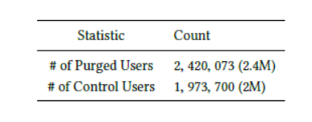
Detecting Purged Users and Creating the Control Dataset
Purged users detection -
Curated 560M Twitter users starting on 4th August 2018 and 11th September 2018 using Twitter API.
Compared between earlier and later user set between those two dates resulting in 2.4M purged users.
Control dataset -
Randomly sampled 2M users from the 560M users which were not suspended.
Table 1. Purged and control users statistics.
Tarannum Zaki CS 895: Web Archiving Forensics On Twitter Purge @tarannum_zaki @WebSciDL

Slide 9
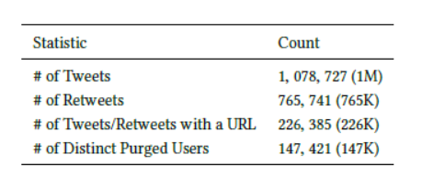
Collecting Tweets
Deployed a Tweet data collector that continuously collected 1% sample Tweet using Twitter Streaming API.
90M tweets made by 19M unique users from 7th December 2017 to 4th August 2018.
After the purge during August 2018, 1M tweets made by 147K unique purged users was filtered out.
Table 2. Tweet Collection statistics.
Tarannum Zaki CS 895: Web Archiving Forensics On Twitter Purge @tarannum_zaki @WebSciDL

Slide 10
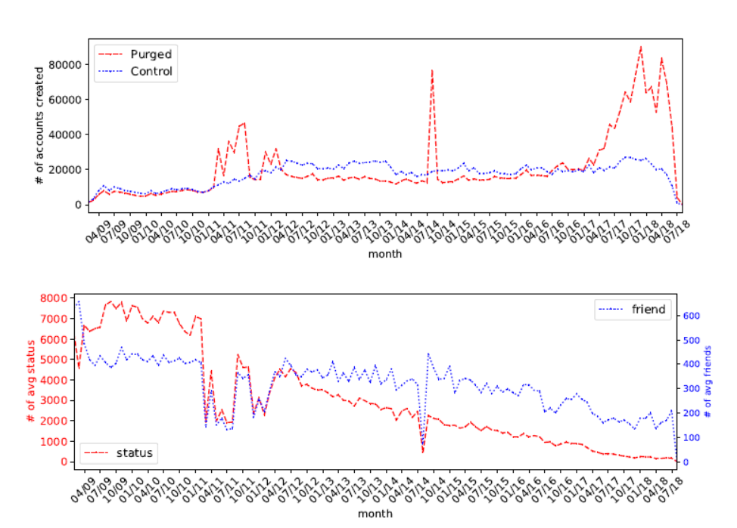
Account Creation Statistics of Purged and Control Users
a prominent anomaly on July ’2014
Twitter being proactive to rules violation during 2017-2018
well -distributed
7 friends, 0 status, account names were Russian, and created seconds apart
Figure 1. (top) Number of accounts created per month for purged and control user set. (bottom) Number of average status and friend of purged users grouped by account creation month.
Tarannum Zaki CS 895: Web Archiving Forensics On Twitter Purge @tarannum_zaki @WebSciDL

Slide 11
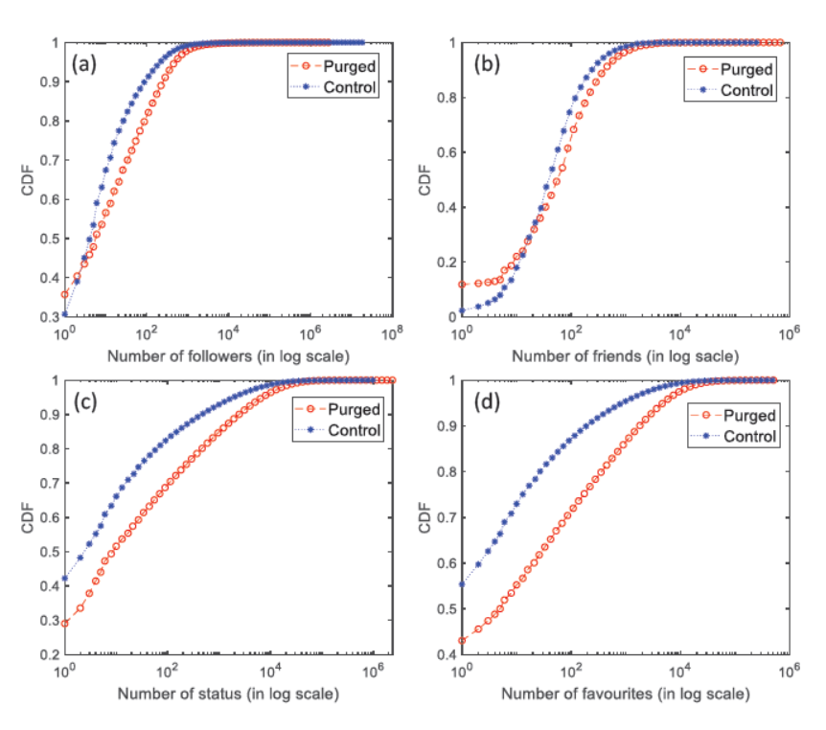
Distributional Properties for Purged and Control Users
Purged users were able to have large number of friends
Purged users were able to build a large follower base
Overall, the purged users were notably more active than the control users based on friends, status, and favorite count
Figure 2. Cumulative Distribution Function of no. of (a) Followers, (b) Friends, (c) Status and (d) Favourites for purged and control set users (note the log-scale x-axis).
Tarannum Zaki CS 895: Web Archiving Forensics On Twitter Purge @tarannum_zaki @WebSciDL

Slide 12
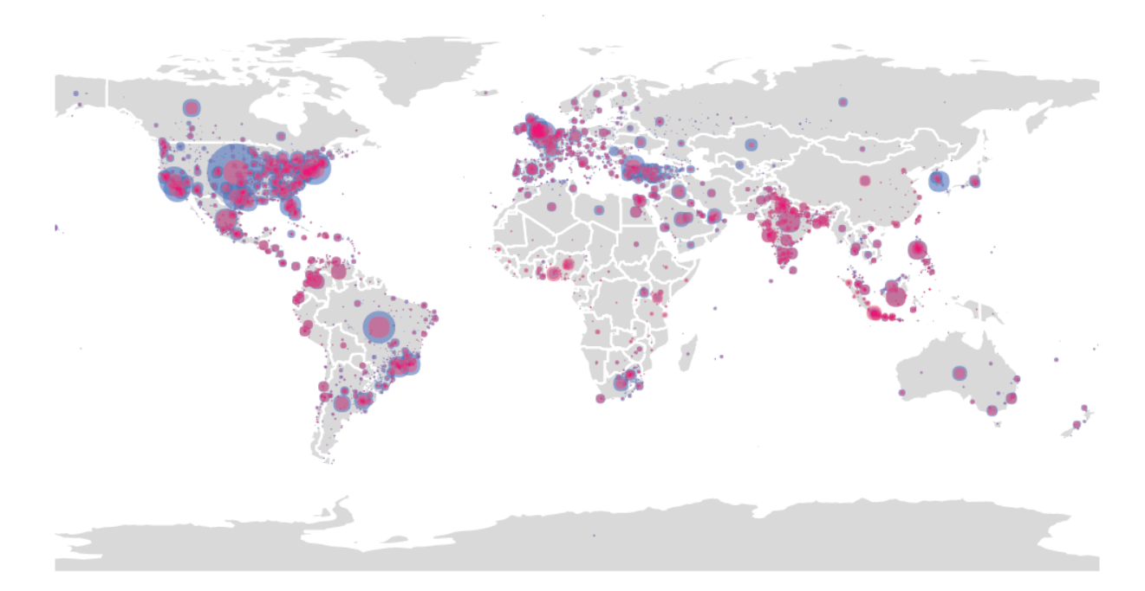
Location of the Purged and Control Users
Turkey has the third highest number of purged users
Highest number of purged users are from the USA
Brazil has the second highest number of purged users
Figure 3. Locations of the purged and control users. Radius is proportional to count. Blue represents the purged users while red represents the control users.
Tarannum Zaki CS 895: Web Archiving Forensics On Twitter Purge @tarannum_zaki @WebSciDL

Slide 13
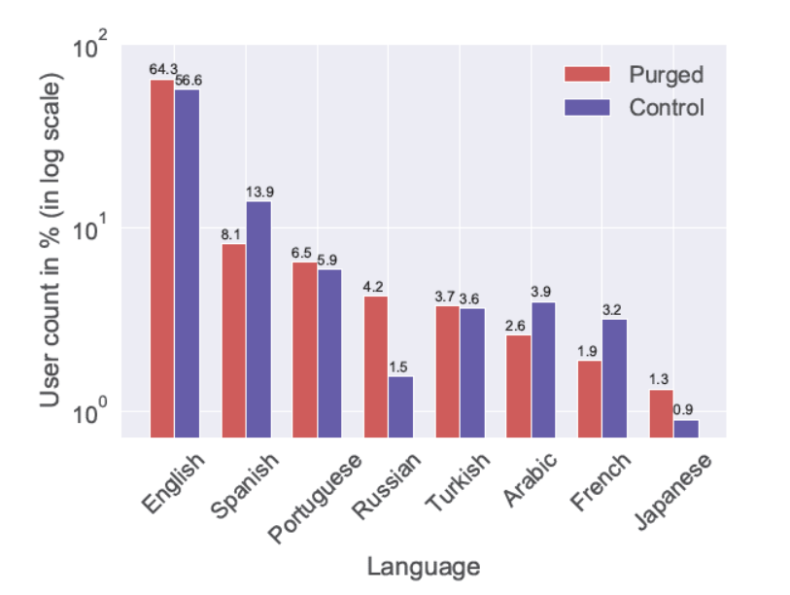
Most-used Language by Purged and Control Users
Control to purged ratio is 1:2.8, which is much higher than any other languages
English, Spanish, and Portuguese have similar occurrence in purged and control
Figure 4. Distribution of the eight most-used languages on Twitter by purged and control users. Note the log scale on the y-axis.
Tarannum Zaki CS 895: Web Archiving Forensics On Twitter Purge @tarannum_zaki @WebSciDL

Slide 14
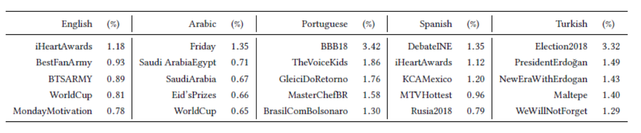
Top Hashtags across Five Most-used Languages
award and musical shows
regional issues
television and reality shows
television and reality shows
political
Table 3. Top hashtags across five most-used languages (Arabic and Turkish are Translated).
Tarannum Zaki CS 895: Web Archiving Forensics On Twitter Purge @tarannum_zaki @WebSciDL

Slide 15
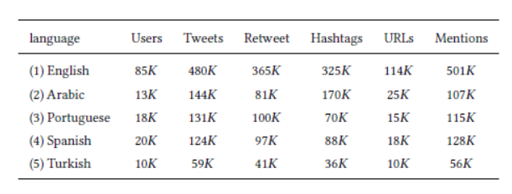
Statistics of Tweets in Five Most-used Languages
Arabic users shared more original content
Mentions are largely used in tweets for English and Spanish
A high activity rate of Arabic users prior to purge.
Table 4. Key statistics of tweets in five most used languages.
Tarannum Zaki CS 895: Web Archiving Forensics On Twitter Purge @tarannum_zaki @WebSciDL

Slide 16
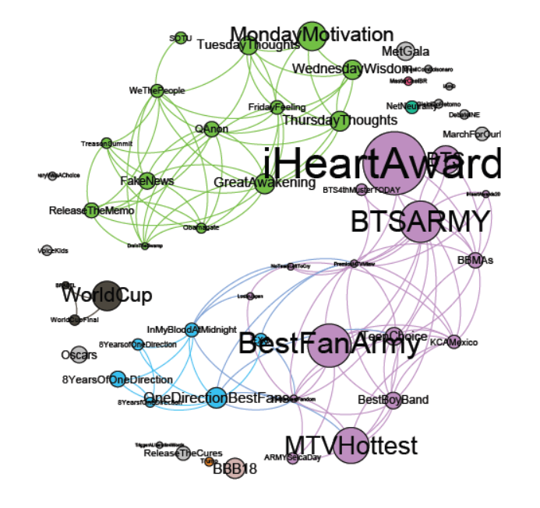
Hashtag Similarity Network and Clusters
political hashtag
musical hashtag
Figure 5. Hashtag similarity network.
Tarannum Zaki CS 895: Web Archiving Forensics On Twitter Purge @tarannum_zaki @WebSciDL

Slide 17
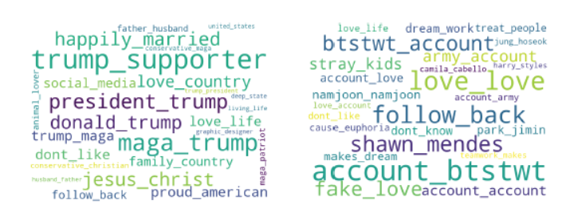
Word bigrams from User’s Profile Description
political-user profiles heavily expressed their political agenda
musical-user profiles explicitly asked for followers, expressed their support for various musical artists
Figure 6. (left) Top-25 word bigrams from political user’s description.(right) Top-25 word bigrams from musical user’s description.
Tarannum Zaki CS 895: Web Archiving Forensics On Twitter Purge @tarannum_zaki @WebSciDL

Slide 18
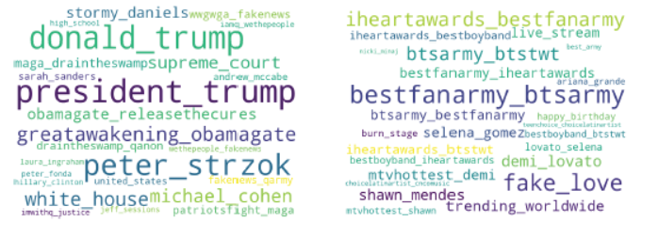
Word bigrams from User’s Tweets
political users mainly engaged in topics related to U.S. President Donald Trump and few political conspiracy theory
musical users mostly talked about various music festivals and music artists
Figure 7. (left) Top-25 word bigrams from political user’s tweets. (right) Top-25 word bigrams from musical user’s tweets.
Tarannum Zaki CS 895: Web Archiving Forensics On Twitter Purge @tarannum_zaki @WebSciDL

Slide 19
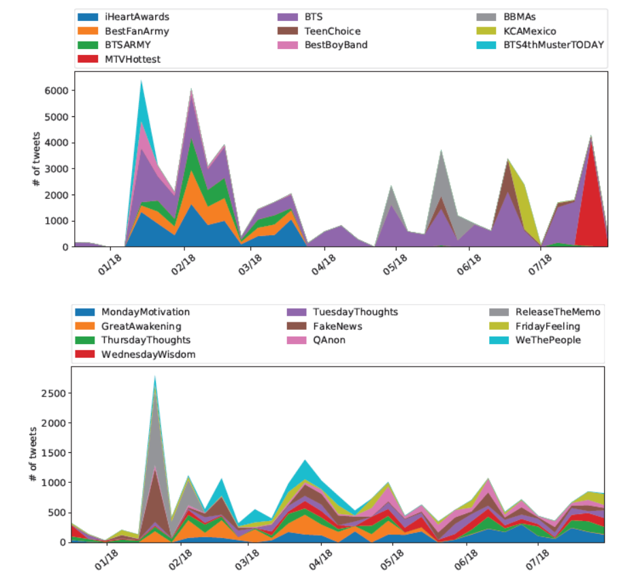
Statistics on Content Dynamics
musical hashtags are largely episodic in nature
political hashtags are largely thematic in nature
Figure 8. (left) (top) Musical hashtags over time. (bottom) Political hashtags over time.
Tarannum Zaki CS 895: Web Archiving Forensics On Twitter Purge @tarannum_zaki @WebSciDL

Slide 20
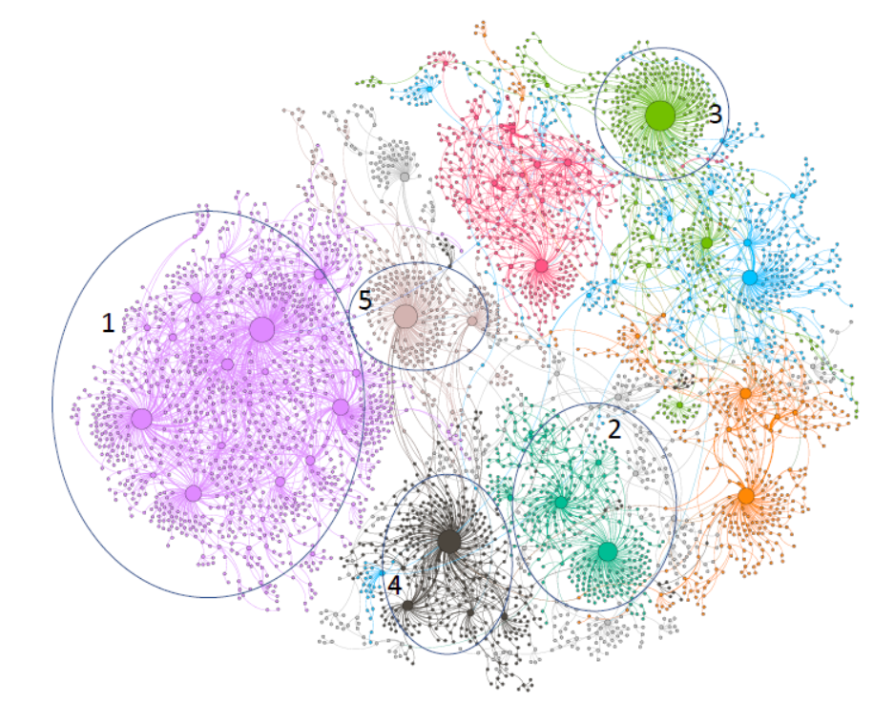
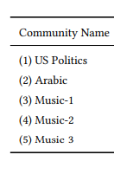
Purged Users Retweet Graph
Figure 9. Purged User’s Retweet Graph (Ten largest clusters are shown). Each node represents a purged user and an edge implies one purged user retweeted another purged user. Here node size is proportional to in-degree (no of times retweeted), and similar color implies same cluster.
Tarannum Zaki CS 895: Web Archiving Forensics On Twitter Purge @tarannum_zaki @WebSciDL

Slide 21
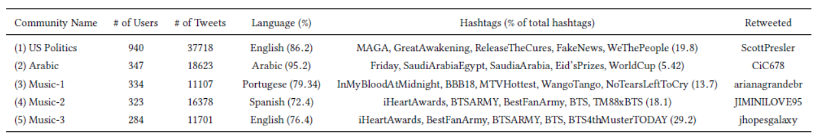
Five Largest Communities from the Retweet Network
Largest community is the US-Politics having high volume of tweets made in English, and the hashtags are related to political propaganda.
The second dense group is the Arabic users who talked about regional issues.
The remaining three communities are focused on musical issues.
Table 5. Key Statistics of five Largest Communities Identified from the Retweet Network.
Tarannum Zaki CS 895: Web Archiving Forensics On Twitter Purge @tarannum_zaki @WebSciDL

Slide 22
Key Findings
Malice in Twitter has spread beyond automated spamming.
Politics is a major conversational topic among the suspended users across language and region.
The suspended users had a follower base similar to regular users.
Purged users exploit hashtag and mention as a key tool to disseminate their content irrespective of language and location.
Political users were persistent in spreading a common agenda over time.
Exploiting retweet information, interaction among the purged users was identified who collaborated towards a similar objective.
Tarannum Zaki CS 895: Web Archiving Forensics @tarannum_zaki @WebSciDL

